Slide 1
Web Architecture
Module-1

Slide 2
Introduction to WWW
WWW stands for World Wide Web.
Web is a collection of resources which contains text,images,audio,video,any data composed as a HTML document.
Resources in the HTML documents are hosted on the server.
Resources on the server can be accessed by entering an URL(uniform resource locator) in the browser.

Slide 3

Client-Server Architecture

Slide 4
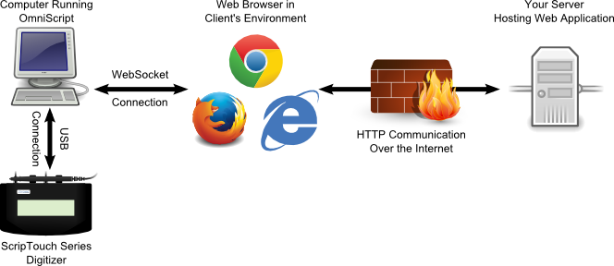
Browser is a client

Slide 5
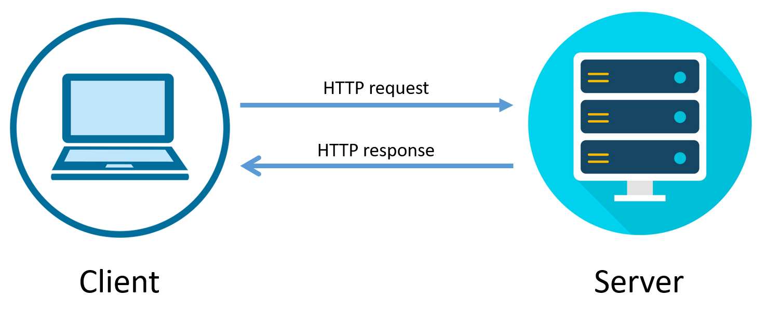
HTTP Communication

Slide 6
HTTP request
GET: simply retrieve data
POST: Asks the server to accept a block of data, usually to create
something(Inserting a data)

Slide 7
HTTP Response
A client sends a Request to the server , server process that request and sends the response with the status code.

Slide 8
Web Application Tools
Browser
Code-Editor
Server-WAMP,LAMP,MAMP,XAMPP.
WAMP: Window Apache Mysql(MariaDB)PHP
LAMP: Linux Apache Mysql(MariaDB) PHP.
MAMP: Macintosh Apache Mysql(MariaDB) PHP.
XAMPP: Cross Platform Apache Mysql(MariaDB) PHP Pearl

Slide 9
Download Xampp
https://www.apachefriends.org/download.html

Slide 10
Developer Tools in Browser
View Page Source
Inspect

Slide 11
Thank you

Slide 12
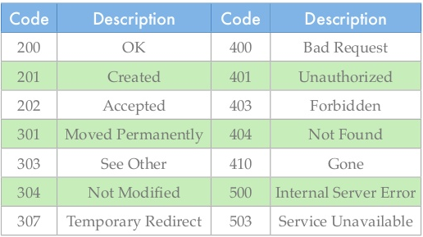
HTTP Response
A client sends a Request to the server , server process that request and sends the response with the status code.

